Slide 1
ETL Project Analysis Presentation By A & B

Slide 2
Project analysis slide 2
ETL Project Analysis
1. Extraction
2. Transformation
Data
3.Load

Slide 3
Project analysis slide 3
ETL Project Analysis
Finding Data
Tool Used for Extraction of Data
Tool Used to Transform Data
Tool Used to Load Data
Data from Kaggle.com 1. World Bank Development Indicator
2. World Bank International Education
3. International Energy Statistics
GCP Big Query Module
Big Query API from GCP
Python
Jupyter Lab
Pandas
Python
PgAdmin4.
Pandas
Python
PgAdmin4

Slide 4
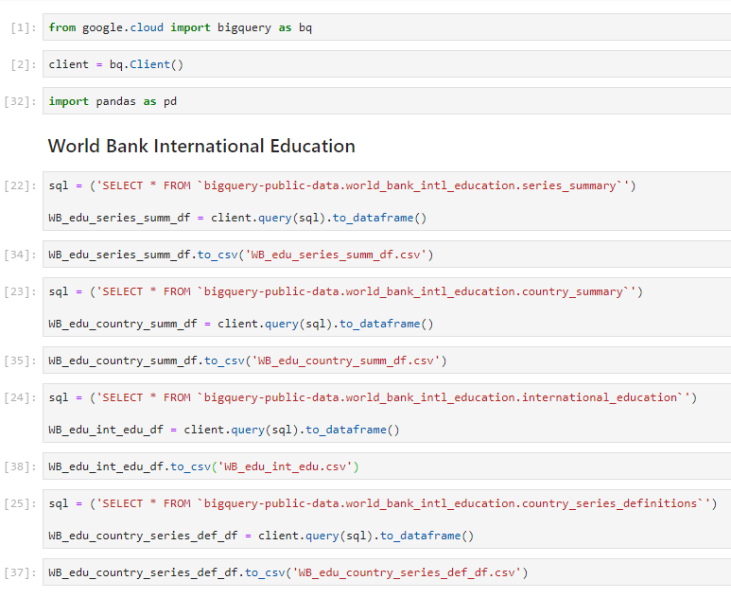
Project analysis slide 4
ETL Project Analysis Extraction
Used Big Query module to extract dataset from GCP. Refer to extract.ipynb
Tasks
Project Objectives
Schedules
Customer Objective
Resources

Slide 5
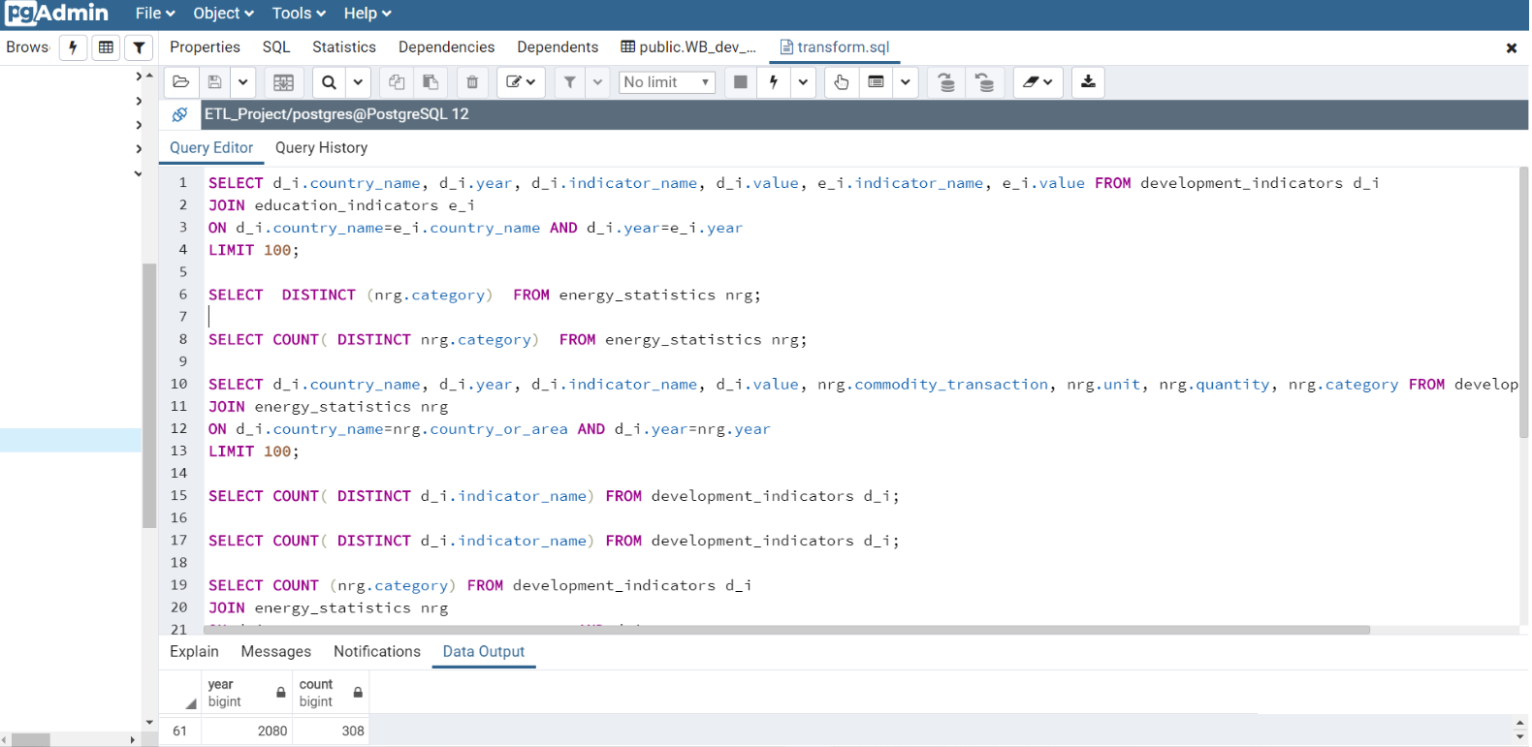
Project analysis slide 5
ETL Project Analysis Transformation
We will have to built a data warehouse to be able to query specific comparisons.

Slide 6
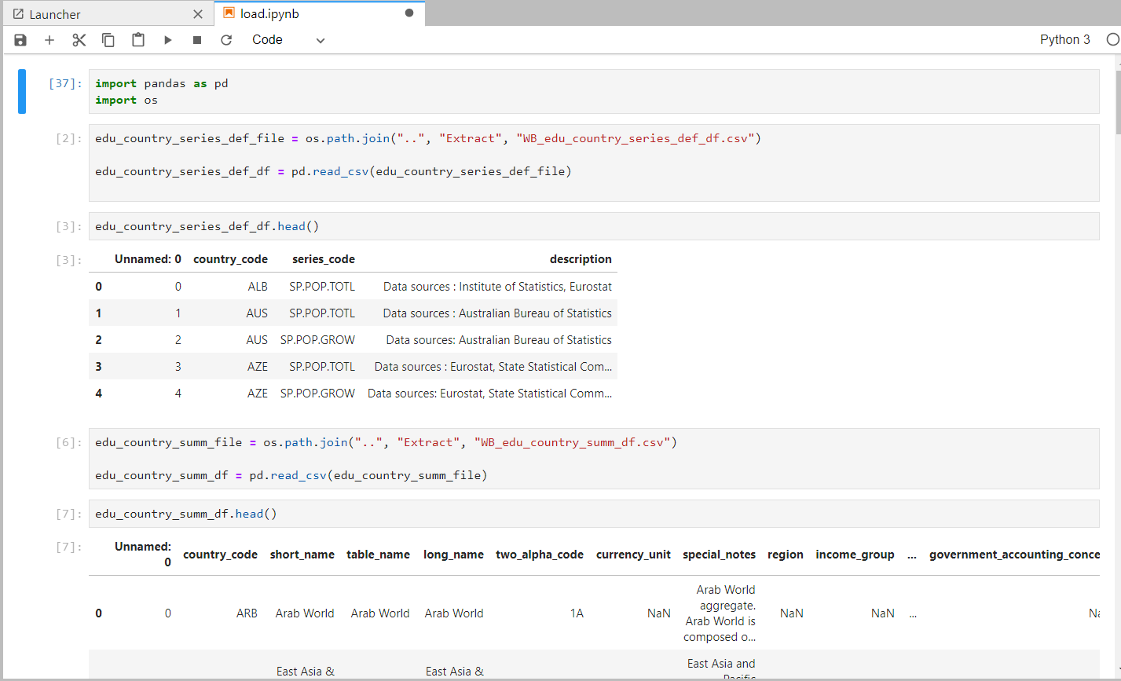
Project analysis slide 5
ETL Project Analysis Load
Loading Data to Database in pgadmin4. Refer to code load.ipynb.

Slide 7
Thank You

